Slide 1
BIG DATA
WELCOME
TO

Slide 2
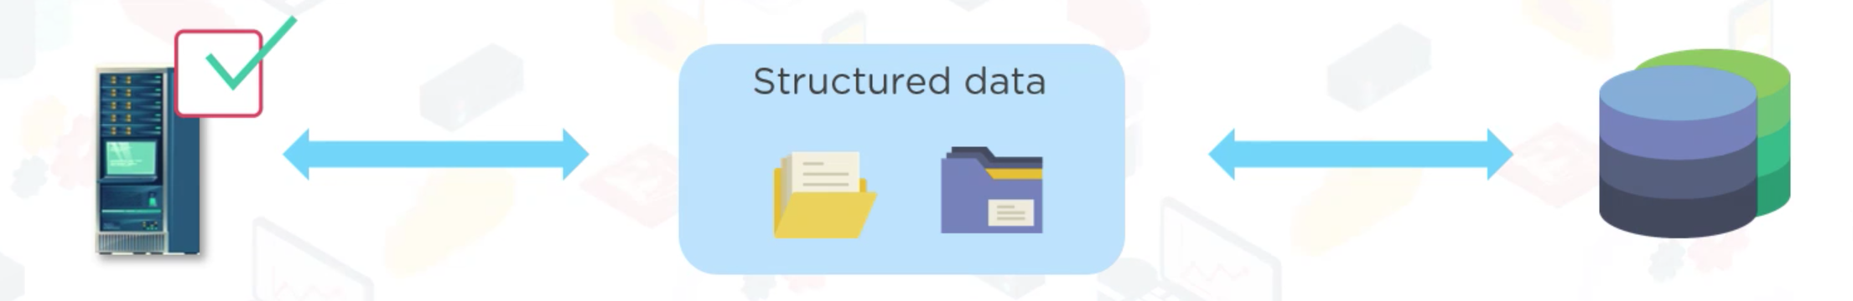
History of Big Data

Slide 3
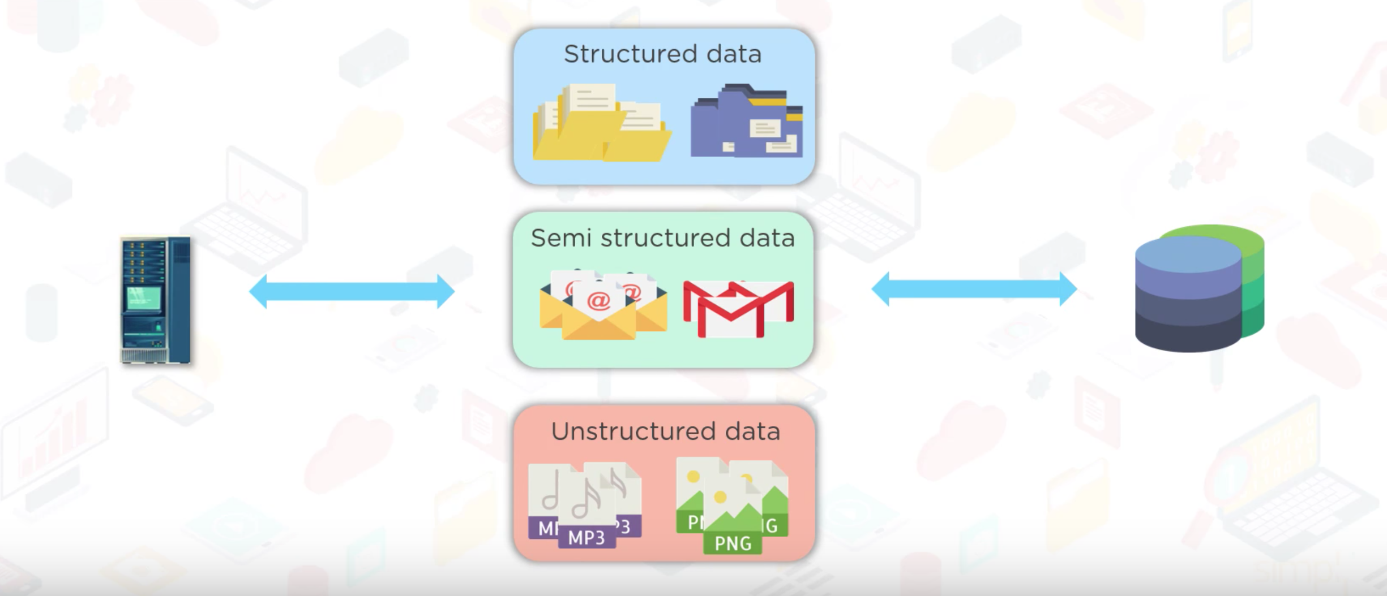
History of Big Data

Slide 4
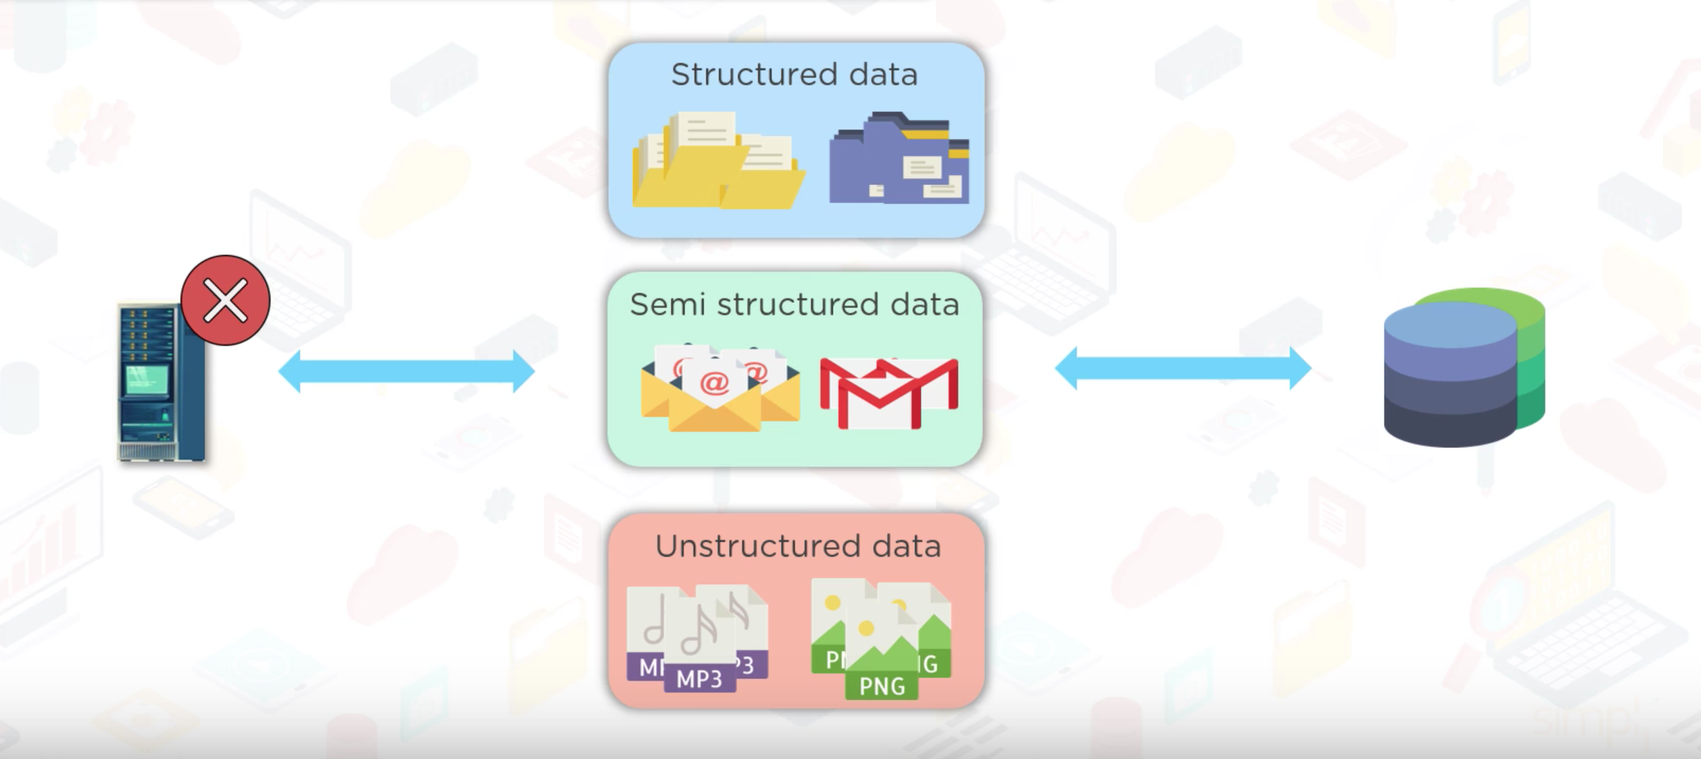
History of Big Data

Slide 5
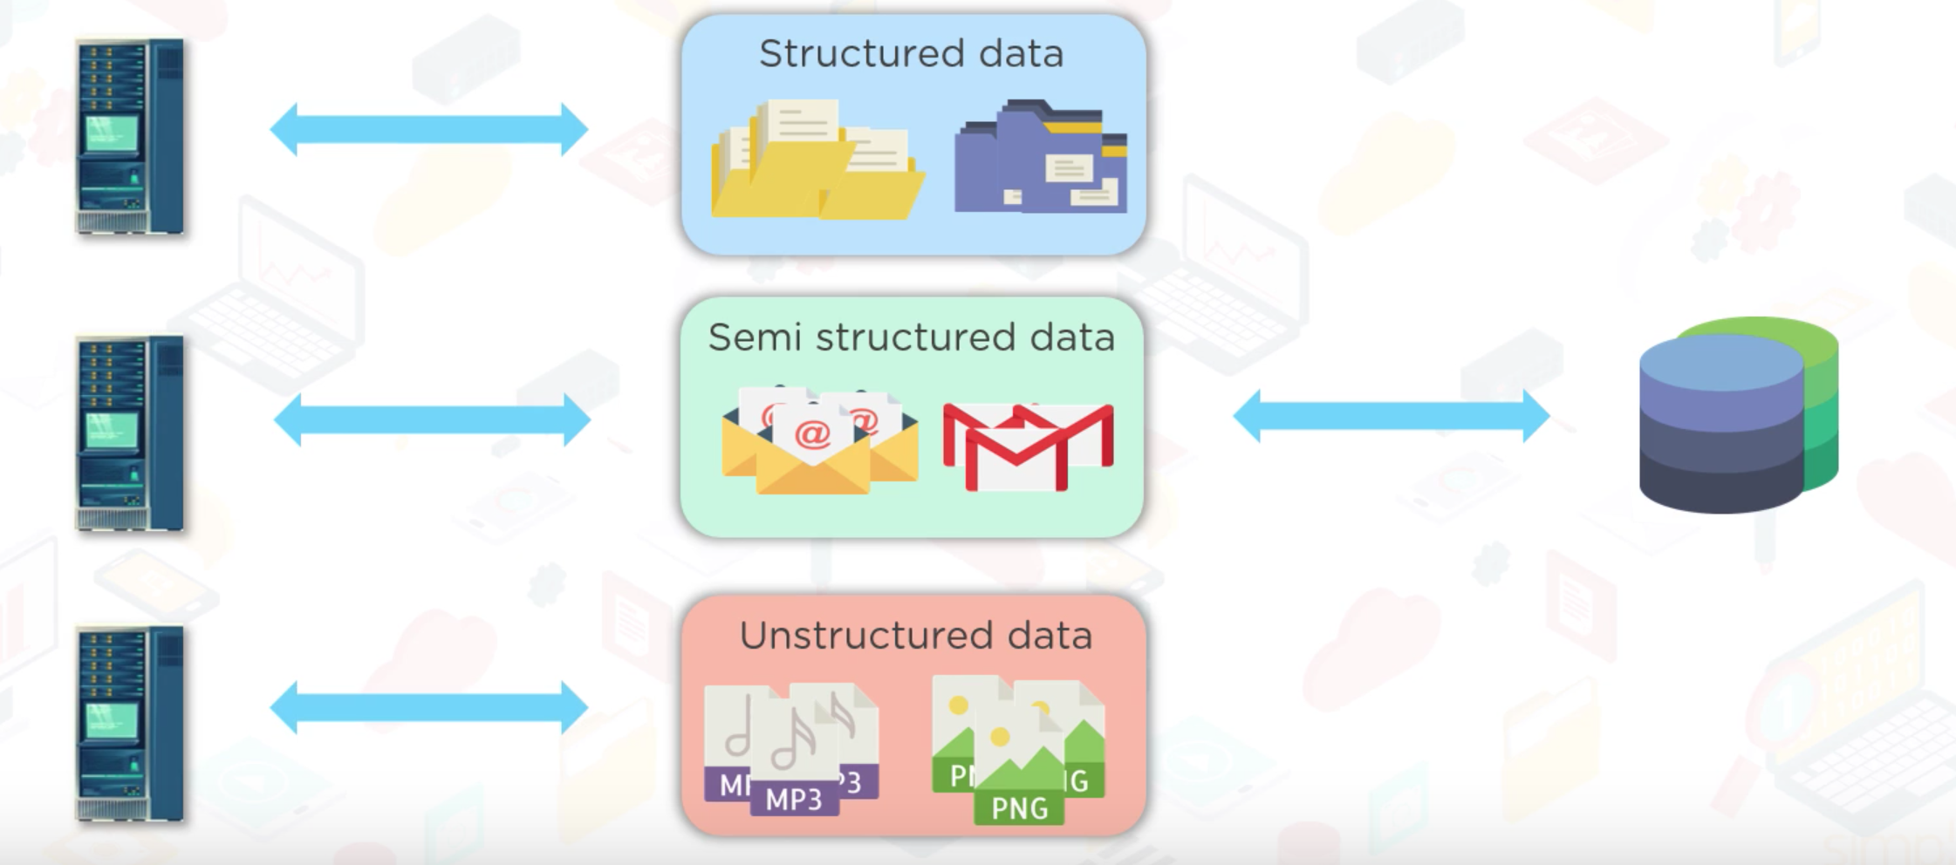
History of Big Data

Slide 6
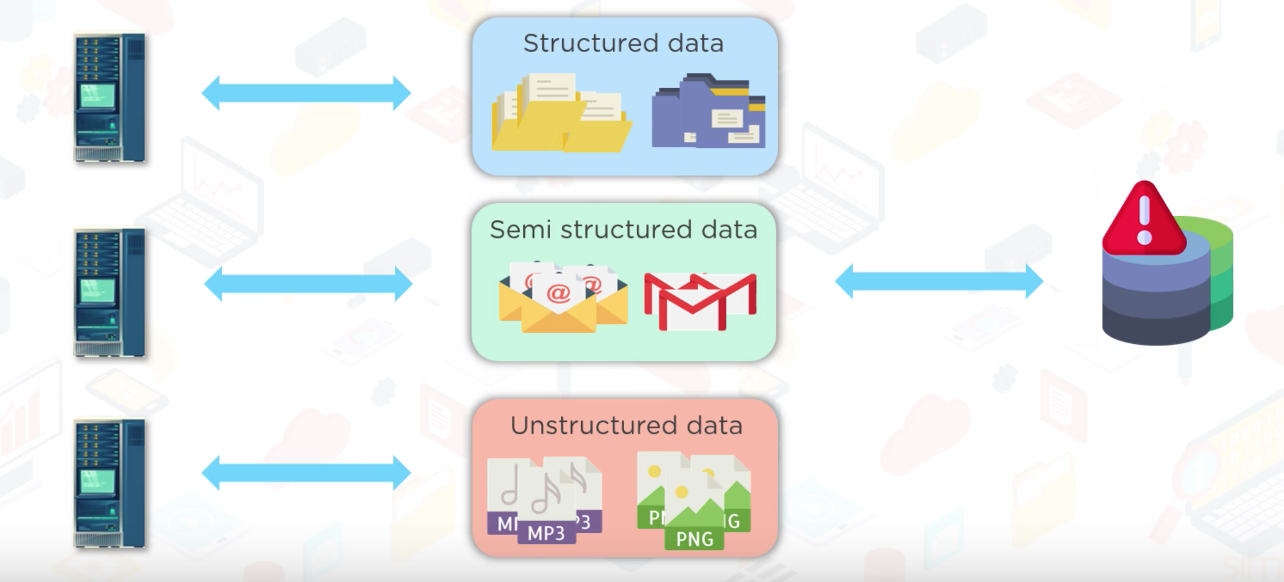
History of Big Data

Slide 7
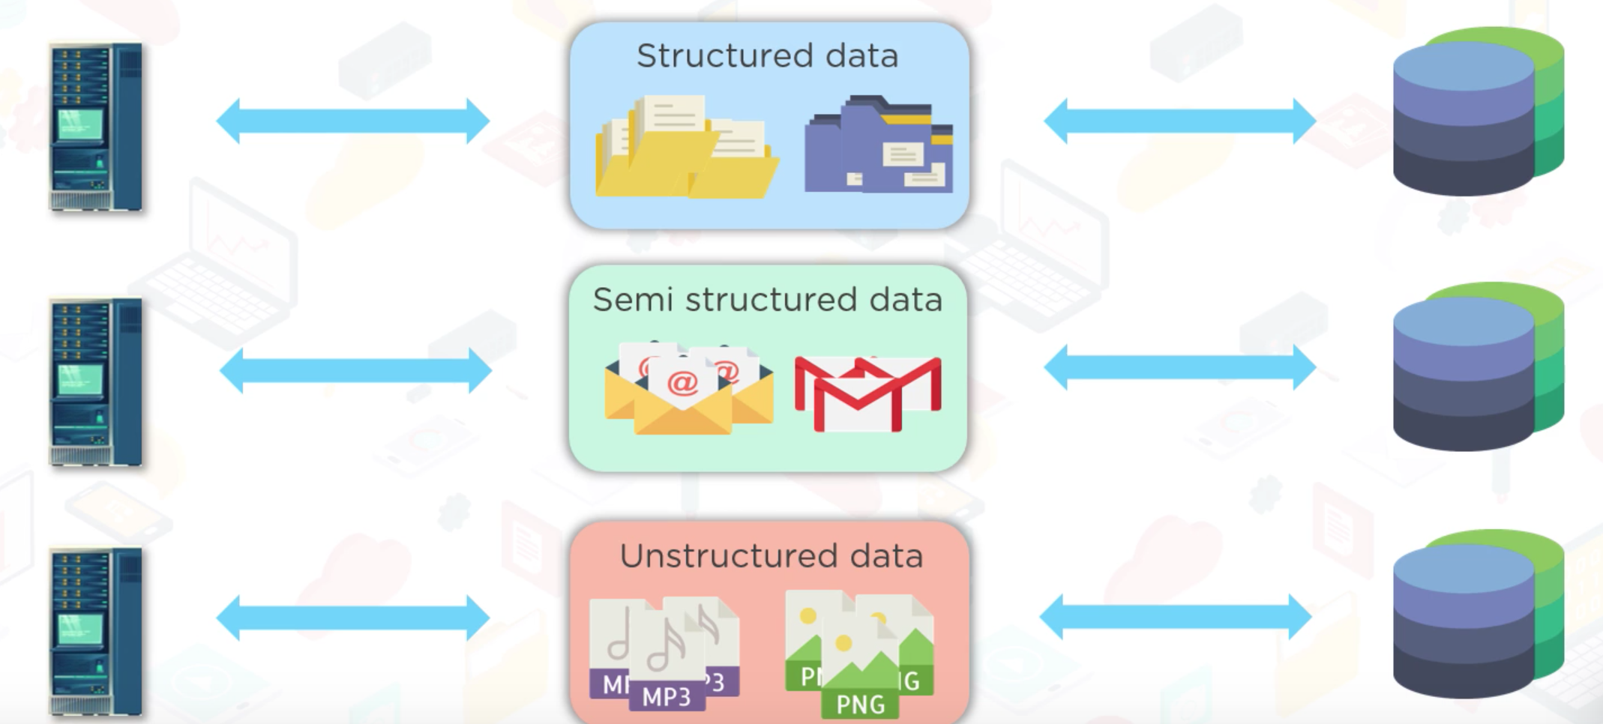
History of Big Data

Slide 8
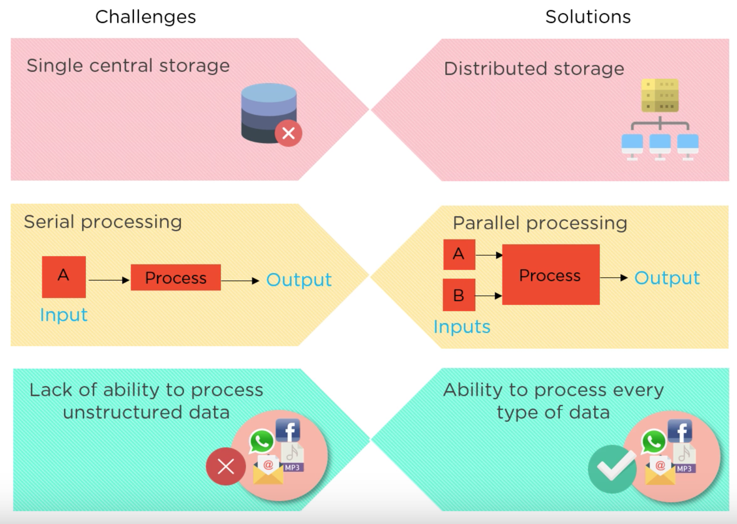
History of Big Data

Slide 9
Hadoop
Hadoop is a framework that manages big data storage in a distributed way and process it parallelly.

Slide 10
Hadoop Components
Hadoop Filing System (HDFS)
Yarn
MapReduce

Slide 11

Hadoop Architecture
NameNode
Master node
Maintains and manages DataNodes
Records metadata
Secondary Namenode
DataNode
Slave node
Store actual data
Serve read and write request from the client

Slide 12
Hadoop Filing System (HDFS)
Distributed file system that allows to store large data across the cluster
Data stores as blocks
Hadoop1 – 64MB
Hadoop 2 – 128MB

Slide 13
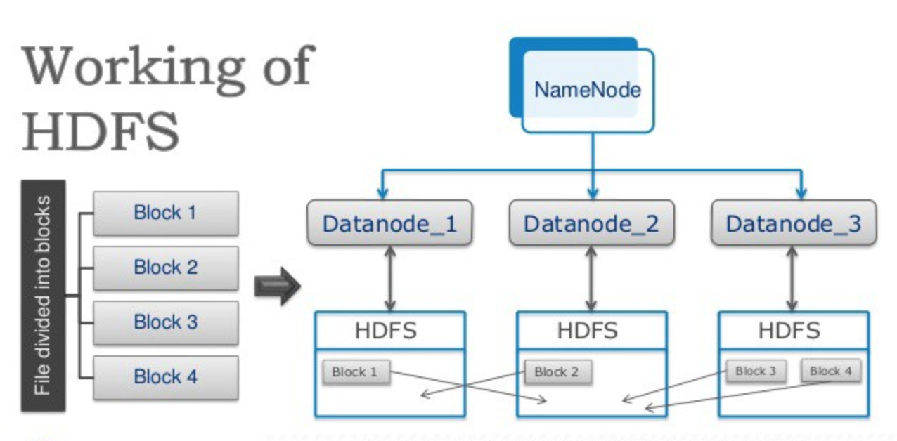
Hadoop Filing System (HDFS)
NameNode
DataNode

Slide 14
Yarn
Yet Another Resource Negotiator
Manage cluster resources
Job scheduling

Slide 15
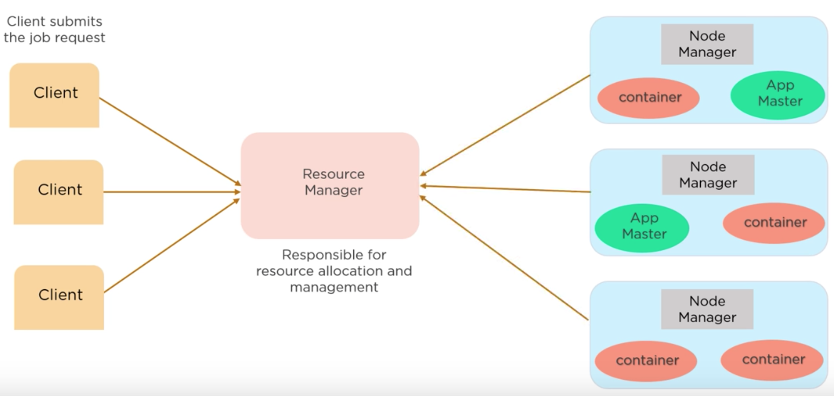
Yarn
NameNode
Resource Manager
DataNode
Node Manager
Container
App Master
Notes:
Node Manager – Manages the nodes and monitors resources.
Container – Is a collection of physical resources such as RAM, CPU
App Master – Requests container form the Node Manager.

Slide 16
Map-Reduce
Hadoop MapReduce is a programming technique where huge data is processed in a parallel and distributed fashion.
Processing is done at the slave node and the result is sent to the master node.

Slide 17
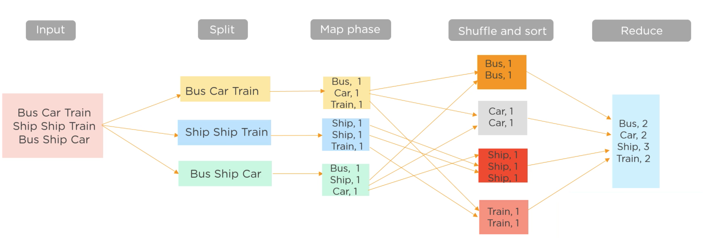
Map-Reduce

Slide 18
Hadoop Ecosystem

